Slide 1

Enhancing Human Potential in Family Business
Awareness on Family Business Dynamics

Slide 2
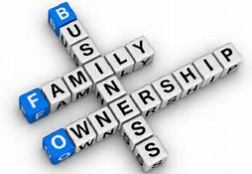
Family Business Facts
Family Business contributes
  60 % of the GDP
  55 % of the employment
  55 % of Market Capitalization
  They outperform non-family run business
  However only 4 % of the family business survive beyond third generation

Slide 3
Family Business: Premature Mortality
First time entrepreneurs
not interested in family perpetuity
unable to let go
sells out early to retire wealthy
Second generation
not interested in joining Family Business
lack of business skills
Sibling disagreements
Indicative Reasons
Low Professionalization
Relationship – Differences in family relationship & emotional discord
Poor Succession Planning
Inter-generational disagreement

Slide 4
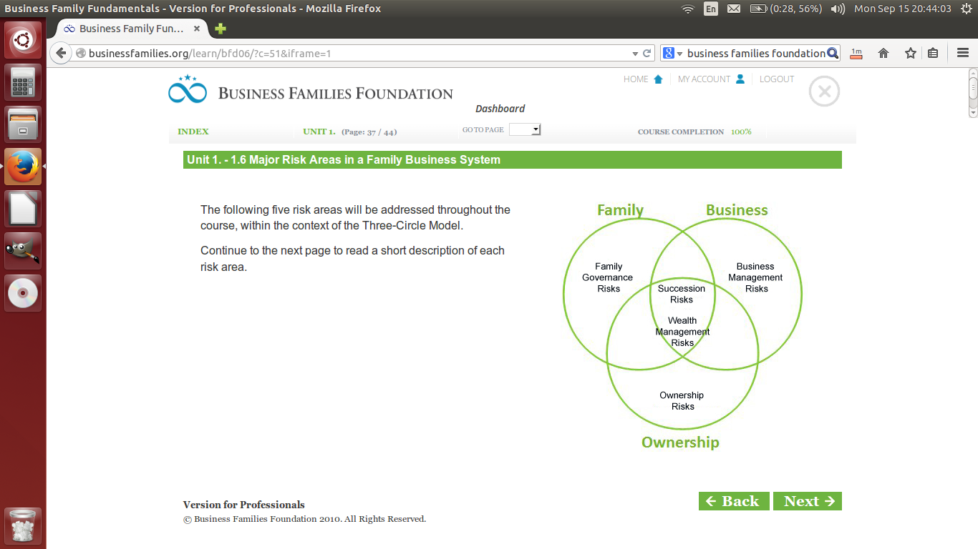
Major Risk Areas in a Family Business System

Slide 5
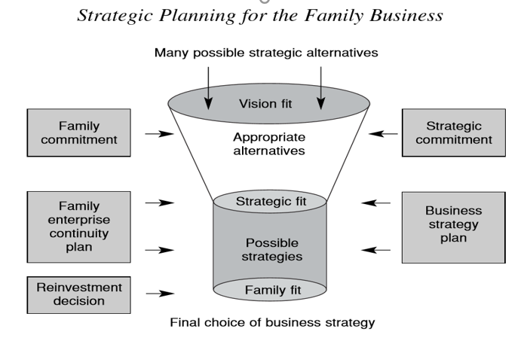

Slide 6
The Family Constitution
  Crystalize a family constitution - robust way of managing family like a business
  Family constitution - captures all aspects of governance that the family believes will guide progress of the family business
  The participative process - enables alignment, synergy and personal development within the family
Notes:
Family Constitution – a participative process to align

Slide 7







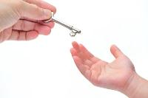


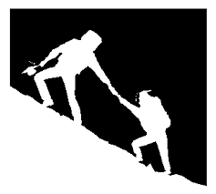

A typical Constitution may illustratively cover the following:
Family jobs for future generation
Remuneration/ compensation & dividends
Managing and resolving differences
Decision-making
Code of Conduct
Media Policy
Family Fund
Succession
Family facilitation policy
Entrepreneurship Development
Exit Process
Venture Fund

Slide 8

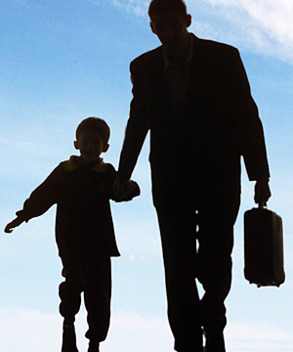
Governance: Integrating the Family & Business Systems
Managing the Family like a Business
Managing the Business like a Family
Family needs to adopt a systems approach for governance:
define the values,
align aspirations,
lay down key polices on succession process,
employment policy for in next generation,
decision making process,
managing and resolving differences,
long term vision etc….
Business has to adopt soft approaches to:
align aspirations of family members,
family values, culture and traditions etc.
demonstrate appreciation of emotions,
address subconscious behaviors with empathy,
exhibit compassion to ensure family harmony.
Family Constitution is an instrument which makes the concept of “Managing the Family as a Business & the Business as a Family” into reality

Slide 9
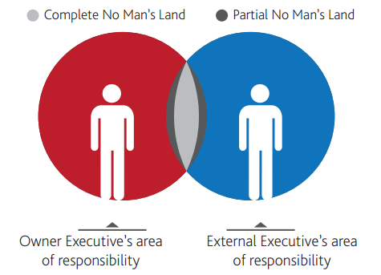
Role of Professionals – “No Man’s Land”
Area of interdependence between owners and their external executives
In anticipation that others will act, lack of trust, fear and role ambiguity lead to inaction by both sets of executives.
Managing this space is the key to professionalize the relationships between Owner Executives and External Executives.
Notes:
Members of Family may not have all the competencies required to develop & implement the strategic vision within the family. It is important to identify the strengths of the members of the family business and bring in professionals where we don’t have the strengths but require them for the execution.
Every professional comes into the system with a promise of free space that would be available for them to function. This space should not be intruded by the family.
The “No Man’s Land” is an area which does not belong to the owner executive or to the external executive.

Slide 10
Our Purpose
To provide Family business with an integrated governance frame work for continuity of family business
  Family, Business and Ownership
To facilitate the process of constitution writing based on the priority and stage of the family business
To enable succession planning through the process of “ Transition”
  Business and Ownership
Developing the next generation for succession
Managing differences through fair process
Adoption of principles of Ownership
Creating an Ethical Will for perpetuity

Slide 11
Our Approach
Road Map for Family Business – Awareness Session
Understanding Family Business Dynamics
Questionnaire Survey and 1X1 Session with Family Members
Prioritization of Policy and process to be adopted
Formation of Councils
And Its Charter
Family Council
What contributes to the family business Mortality?
How to Develop a Structure of Governance – Family, Business and Ownership
What are the current challenges / opportunities in the family business
Defining Structure,
Roles & Responsibility
Decision Making Process
- Transition from a Owner Driven Business to a Management
- Delegation of Authority - RASCI
Ownership Principles and Structure
- Ownership
Agreement
- Creation of Will
- Trust Structure
- Estate Planning
- Tax Planning
- Family Fund Policy
- Exit Policy
- Conflict of Interest
Formation of Business Board
- Formation Business Board Charter
- Identification of Board Members
- Operationalization of the Board function
What are the expectation by the family from the process.
Business Council
Ownership Council
Next generation
Council
NBFC
Talent Committee
Code Of Conduct
Family and Business Values and Purpose

Slide 12



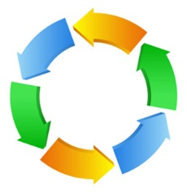


Good Culture precedes all success
Mission
Ideology
Values
Performance
Culture
Institution
Perpetuity
Governance
Belonging

